Slide 1
PART II DIGITAL ELECTRONICS
Chapter 4 : Number systems and Codes
Reference:
Malvino and Leach, Digital Principles & applications, 7th edition, TMH, 2010
Morris Mano, “Digital design”, Prentice Hall of India, Third Edition.

Slide 2
Module 2: Codes
Learning outcomes
At the end of this module, students will be able to:
Discuss different binary combinations to represent code characters.
Explain error detection using parity bit.
Describe error correction using hamming code.

Slide 3
Codes: Group of symbols based on certain rules
Weighted codes: Codes that obey positional weights
Non-weighted codes: Codes that does not obey positional weights

Slide 4
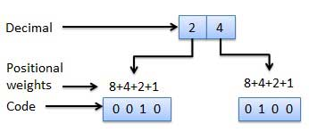
Binary coded decimal codes
Weighted Codes

Slide 5
Weighted codes
Weighted binary codes are those binary codes which obey the positional weight principle.
Each position of the number represents a specific weight.
There exists a fixed weight associated with each bit position in the binary representation of the code character.

Slide 6
Decimal number (A)₁₀
Encoded in the binary form as a₃ a₂ a₁ a₀.
w₃, w₂, w₁ and w₀ are the weights selected for a given
code
(A)₁₀ = w₃a₃ + w₂a₂ + w₁a₁ +w₀a₀
The more popularly used codes have these weights as
W₃ | W₂ | W₁ | W₀
8 | 4 | 2 | 1
2 | 4 | 2 | 1
8 | 4 | -2 | -1

Slide 7
Binary Coded Decimal code (BCD)
Consider the number (16.85)₁₀
(16.85)₁₀ = (0001 0110 . 1000 0101)

Slide 8
Non-Weighted Code is one in which the positions in the code do not have a specific weight.
Examples are
1.EXCESS-3 CODE
2.GRAY CODE

Slide 9
Binary coded decimal codes
Decimal | Weighted Codes |  | Un-Weighted Codes
 | 8421BCD | 2421BCD | Excess-3 | Gray code
0 | 0000 | 0000 | 0011 | 0000
1 | 0001 | 0001 | 0100 | 0001
2 | 0010 | 0010 | 0101 | 0011
3 | 0011 | 0011 | 0110 | 0010
4 | 0100 | 0100 | 0111 | 0110
5 | 0101 | 1011 | 1000 | 0111
6 | 0110 | 1100 | 1001 | 0101
7 | 0111 | 1101 | 1010 | 0100
8 | 1000 | 1110 | 1011 | 1100
9 | 1001 | 1111 | 1100 | 1101
 |  | Self complementing codes

Slide 10
Self complementing codes
A code is said to be self complementary if the codeword of 9’s complement of that number can be obtained by inverting every bit
Example: Consider the 2421 code.
The 2421 code of (4)₁₀ is 0100.
Its complement is 1011 which is 2421 code for (5)₁₀ = (9 - 4)₁₀.

Slide 11
XS-3 or Excess 3 code: Non weighted code derived from 8421 BCD by adding 3 to each code
The purpose of Gray code is to encode binary numbers in such a way that the Hamming distance (number of bits on which the numbers differ) between any two consecutive numbers is always exactly one. This is accomplished by reordering the binary encoding so that any two consecutive numbers only differ by a single bit.

Slide 12
Self Test
What do you mean by a code word?
What are the two types of BCD codes?
What do you mean by self – complementing code?

Slide 13
Binary to Gray-code conversion

Slide 14
Gray-code to Binary conversion

Slide 15
Error Detection and Correction
Introduction
Single bit Error detection using parity bit
Single bit error correction using (7,4) Hamming code

Slide 16
Introduction
When data is transmitted in digital form from one place to another place through a transmission channel some data bits may be modified.
In a communication system data integrity is extremely important.
Ability to identify the error is called the error detection. It would be preferred even well if we can correct the error besides detection.
A code which has the ability to correct is called error correction code.

Slide 17
Error Detection Codes
Parity: Number of ones in the given code word.
Adding an extra bit to each word being transmitted
Even parity: Total number of 1’s including the parity bit is even.
Odd parity: Total number of 1’s including the parity bit is odd.
At the receiver, error can be detected if the total number of 1’s is odd in an even parity scheme and even in an odd parity scheme
Limitation: Only single bit error can be detected. Location of error cannot be found
Notes:
Even parity: The parity bit is set to 0 or 1 at the transmitter in such a way that the total number of 1’s in the resulting code word (including the parity) bit is an even number.
Odd parity: The parity bit is set to 0 or 1 at the transmitter in such a way that the total number of 1’s in the resulting code word (including the parity bit) is an odd number.

Slide 18
Word | Odd parity bit | Even parity bit
0001
0100
0101
0111

Slide 19
Error Detection Codes
Example: In an even parity scheme, which of the following words contain an error?
a. 10101010
b. 1110110
c. 10111001
Example: In an odd parity scheme, which of the following words contain an error?
a) 10110111
b) 10011010
c) 11101010
Notes:
Even parity: The parity bit is set to 0 or 1 at the transmitter in such a way that the total number of 1’s in the resulting code word (including the parity) bit is an even number.
Odd parity: The parity bit is set to 0 or 1 at the transmitter in such a way that the total number of 1’s in the resulting code word (including the parity bit) is an odd number.

Slide 20
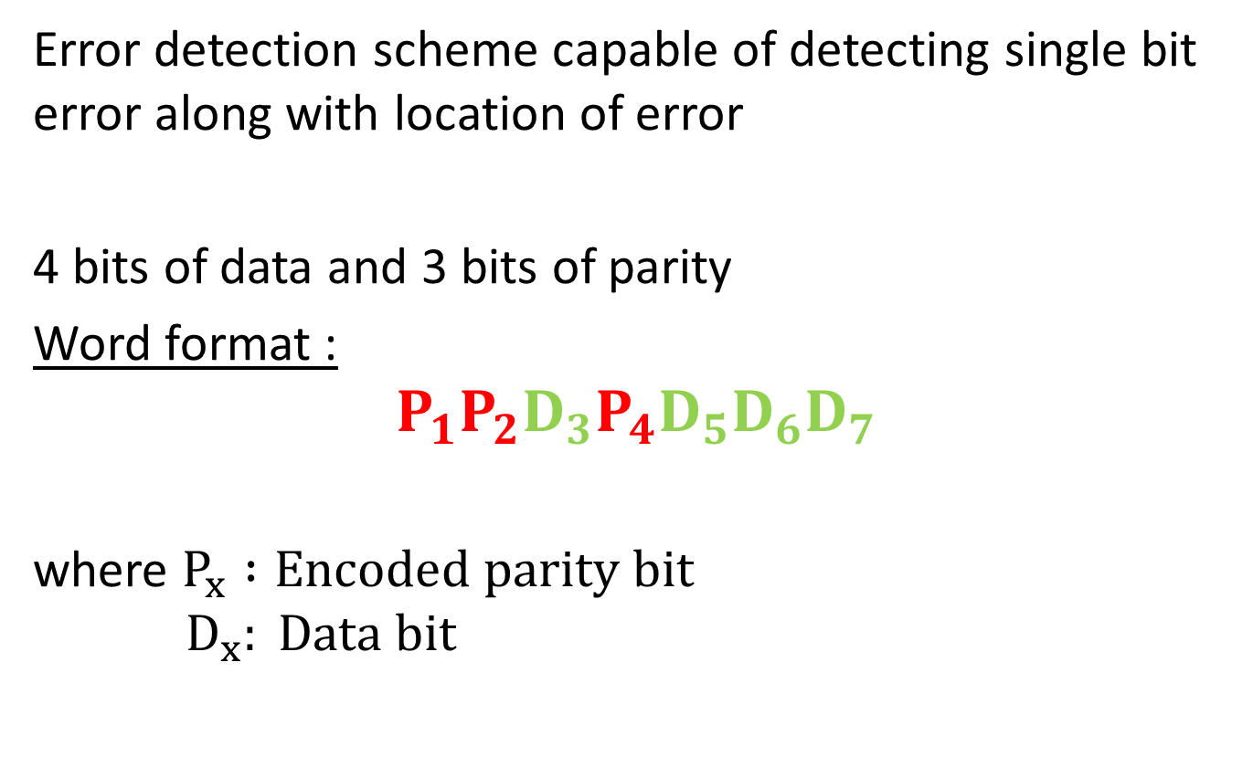
(7,4) Hamming code
Error detection scheme capable of detecting single bit error along with location of error
4 bits of data and 3 bits of parity
Word format :
$$P_{1}P_{2}D_{3}P_{4}D_{5}D_{6}D_{7}$$
where $P_{x} :Encoded parity bit$
$$D_{x}: Data bit$$

Slide 21
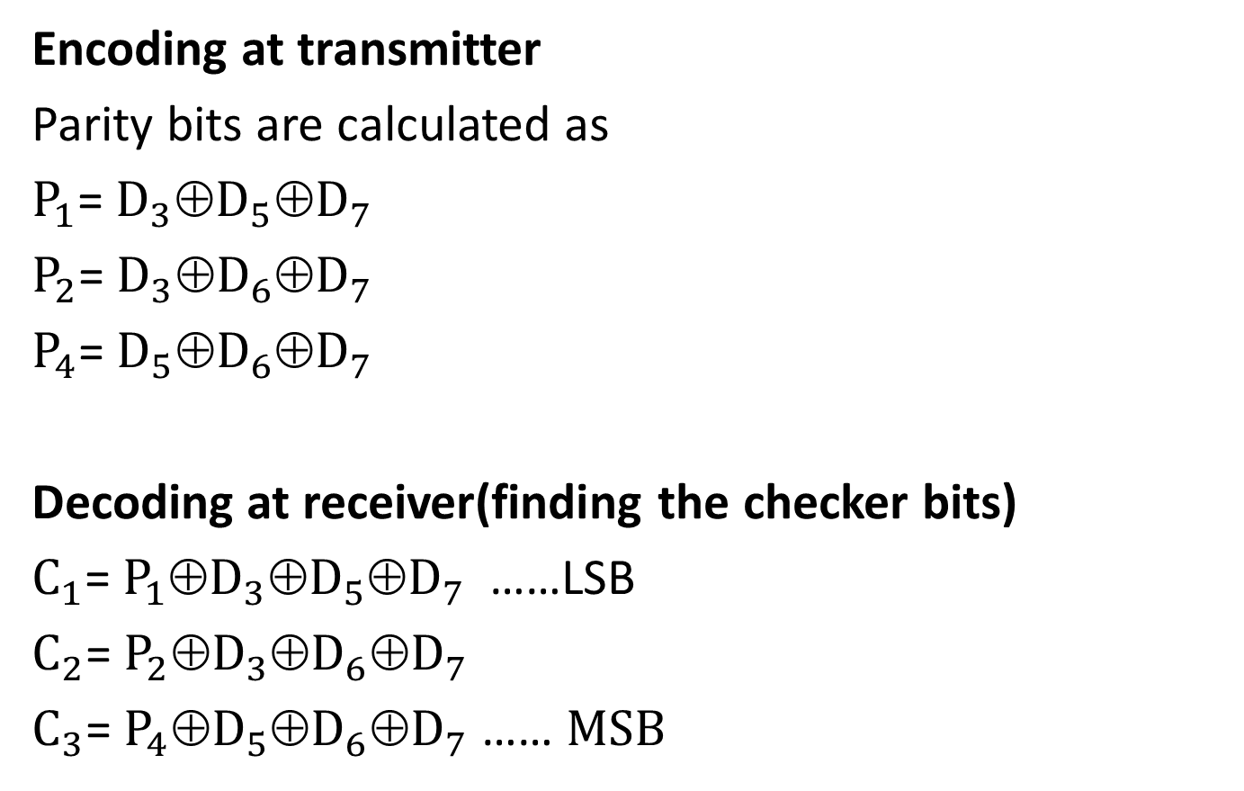
Encoding at transmitter
Parity bits are calculated as
$P_{1}$= $D_{3}\text{⊕}D_{5}\text{⊕}D_{7}$
$P_{2}$= $D_{3}\text{⊕}D_{6}\text{⊕}D_{7}$
$P_{4}$= $D_{5}\text{⊕}D_{6}\text{⊕}D_{7}$
Decoding at receiver(finding the checker bits)
$C_{1}$= ${P_{1}\text{⊕}D}_{3}\text{⊕}D_{5}\text{⊕}D_{7}$……LSB
$C_{2}$= ${P_{2}\text{⊕}D}_{3}\text{⊕}D_{6}\text{⊕}D_{7}$
$C_{3}$= ${P_{4}\text{⊕}D}_{5}\text{⊕}D_{6}\text{⊕}D_{7}$ …… $MSB$

Slide 22
Example: Encode 1101 into a 7 bit even parity hamming code.

Slide 23
Example:
The message below coded in the 7 bit Hamming code is transmitted through a noisy channel. Decode the message assuming that at the most a single bit error has occurred.
1001001

Slide 24
Summary
Different forms of BCD representation
Weighted and non weighted codes
Error detection using parity bit.
Error correction using Hamming code.

